Slide 1





CAREER
ORIENTED
PRESENTATION
BY SOHOM SARKAR
" YOUR CAREER IS YOUR STORY - MAKE IT INSPIRING "

Slide 2
TABLE
OF CONTENTS
Introduction
01
Future Scope
05
Self-Assessment
02
Networking
06
Career Exploration
Career Milestones
03
Conclusion
07
07
Skill Development
04

Slide 3
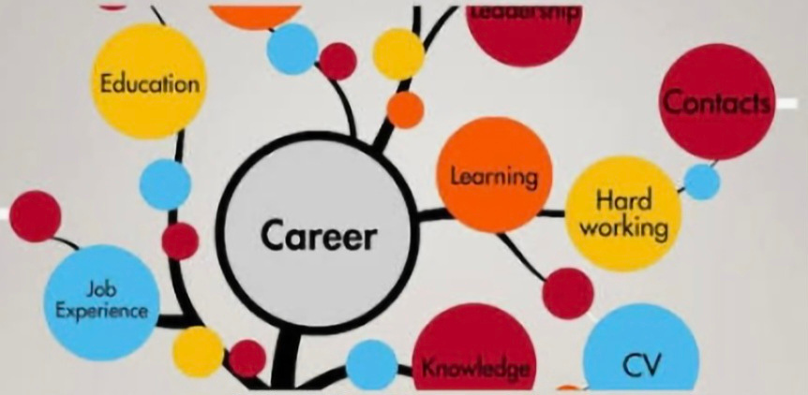

INTRODUCTION
Good morning everyone,
I am Sohom Sarkar , a student of B.Tech in Computer Science and Engineering at Rungta International Skills University. Today, I am going to present my Career Oriented Presentation, where I will discuss my career goals, the skills required to achieve them, and the steps I am taking to build a successful future in the field of computer science.
01

Slide 4
SELF - ASSESSMENT
ABOUT :
KEY POINTS :
I try to know my skills like coding and communication.
I find out what I really enjoy doing.
I think about my values and what matters to me in a job.
I check my personality and the way I like to work.
I set simple and real goals for my career.
Self assessment means knowing myself better.
It helps me to find out my strengths, weaknesses, interests and goals so that I can choose the right career path.
As a B.Tech CSE student, I try to understand what I am good at and what I need to improve for my future in the tech field.
02

Slide 5


CAREER EXPLORATION
ABOUT :
Career exploration means learning about different jobs and fields related to my course.
It helps me understand what kind of work I want to do in the future and what skills are needed for it.
As a CSE student, I explore areas like software development, web designing, data science, and artificial intelligence to find what suits me best.
KEY POINTS :
I learn about different career options in computer science.
I check what skills and qualifications each career needs.
I explore job roles like software engineer, web developer, or data analyst.
I plan to gain experience through projects and internships.
03

Slide 6
SKILLS DEVELOPMENT
ABOUT :
KEY POINTS :
I learn programming languages like C, C++, Python, and Java.
I work on projects to get practical knowledge.
I improve my communication and teamwork skills.
I take online courses and attend workshops.
I keep updating myself with new technologies.
Keep learning through online courses and self-study
Develop a growth mindset and adapt to new technologies
Skill development means improving my abilities and learning new things that help me in my career.
As a Computer Science student, I focus on building both technical and soft skills to become ready for future job opportunities.
04

Slide 7

FUTURE SCOPE
ABOUT :
Future scope means the opportunities and growth I can have in my career after completing my degree.
As a Computer Science and Engineering student, there are many fields where I can build a good future, like software development, AI, data science , front-end and back-end developer.
KEY POINTS :
High demand for IT professionals in India and abroad.
Many job roles like software engineer, web developer, data analyst, etc.
Scope for higher studies like M.Tech or MBA.
Opportunities in government and private sectors.
Possibility to start my own tech startup in the future.
05

Slide 8

NETWORKING
ABOUT :
KEY POINTS :
Networking means building good connections with people who can guide or help me in my career.
It helps me learn from others, find new opportunities, and grow in the professional world.
career insights.
I connect with seniors, teachers, and industry experts.
I join tech events, seminars, and webinars.
I use LinkedIn and online platforms to build contacts.
I share ideas and learn from others’ experiences.
Good networking can help me get internships and jobs.
06

Slide 9

CONCLUSION
In this presentation, I learned about my career goals and the steps I need to take to achieve them.
By doing self-assessment, exploring careers, developing skills, and building networks, I can prepare myself for a successful future in the field of computer science.
I will keep learning and improving to make my career strong and meaningful.
07

